Slide 1
C#
Курс лекций

Slide 2
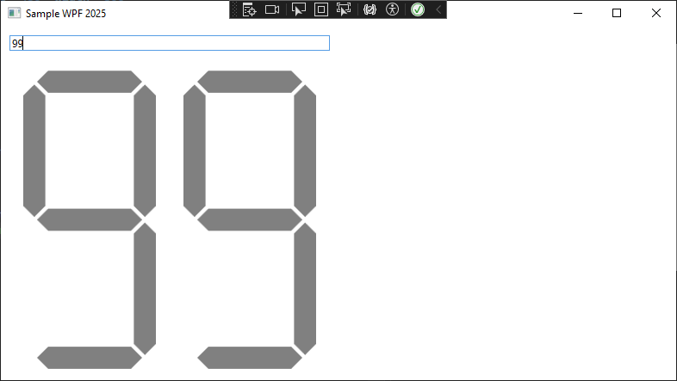
Задача

Slide 3
Model & ViewModel
using ReactiveUI;
using ReactiveUI.Fody.Helpers;
namespace SampleWpf2025.Models
{
internal class MainModel : ReactiveObject
{
[Reactive] public int Input { get; set; }
}
}
using SampleWpf2025.Models;
namespace SampleWpf2025.ViewModels;
internal class MainViewModel
{
public MainModel Model { get; set; } = new MainModel();
}

Slide 4
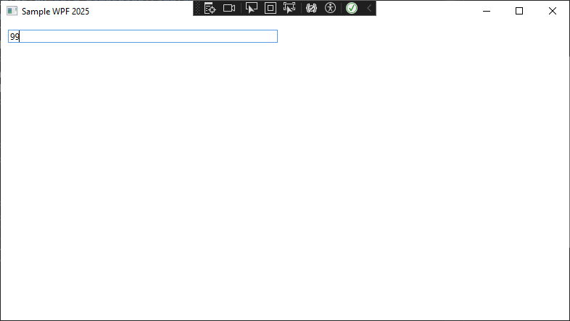
MainView
<Window x:Class="SampleWpf2025.Views.MainView"
xmlns="http://schemas.microsoft.com/winfx/2006/xaml/presentation"
xmlns:x="http://schemas.microsoft.com/winfx/2006/xaml"
xmlns:d="http://schemas.microsoft.com/expression/blend/2008"
xmlns:mc="http://schemas.openxmlformats.org/markup-compatibility/2006"
xmlns:local="clr-namespace:SampleWpf2025.Views"
xmlns:components="clr-namespace:SampleWpf2025.Components"
xmlns:vm="clr-namespace:SampleWpf2025.ViewModels"
xmlns:cv="clr-namespace:SampleWpf2025.Converters"
mc:Ignorable="d"
Title="Sample WPF 2025" Height="450" Width="800">
<Window.DataContext>
<vm:MainViewModel/>
</Window.DataContext>
<Grid>
<Grid.ColumnDefinitions>
<ColumnDefinition/>
<ColumnDefinition/>
</Grid.ColumnDefinitions>
<Grid.RowDefinitions>
<RowDefinition Height="Auto"/>
<RowDefinition/>
</Grid.RowDefinitions>
<TextBox Text="{Binding Model.Input, UpdateSourceTrigger=PropertyChanged}" Margin="10"/>
</Grid>
</Window>

Slide 5
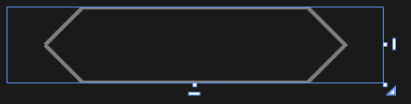
Mark
<UserControl x:Class="SampleWpf2025.Components.Mark"
xmlns="http://schemas.microsoft.com/winfx/2006/xaml/presentation"
xmlns:x="http://schemas.microsoft.com/winfx/2006/xaml"
xmlns:mc="http://schemas.openxmlformats.org/markup-compatibility/2006"
xmlns:d="http://schemas.microsoft.com/expression/blend/2008"
xmlns:local="clr-namespace:SampleWpf2025.Components"
mc:Ignorable="d" Foreground="Black"
x:Name="DigitMark">
<Grid>
<Path Stroke="Gray" Width="100" Height="20">
<Path.Data>
<PathGeometry>
<PathFigure StartPoint="10,10">
<LineSegment Point="20,0" />
<LineSegment Point="80,0" />
<LineSegment Point="90,10" />
<LineSegment Point="80,20" />
<LineSegment Point="20,20" />
<LineSegment Point="10,10" />
</PathFigure>
</PathGeometry>
</Path.Data>
</Path>
<Path Fill="{Binding ElementName=DigitMark, Path=Color}" Width="100" Height="20"
Visibility="{Binding ElementName=DigitMark, Path=MarkVisible}">
<Path.Data>
<PathGeometry>
<PathFigure StartPoint="12,10">
<LineSegment Point="20,2" />
<LineSegment Point="80,2" />
<LineSegment Point="88,10" />
<LineSegment Point="80,18" />
<LineSegment Point="20,18" />
</PathFigure>
</PathGeometry>
</Path.Data>
</Path>
</Grid>
</UserControl>

Slide 6
Mark
public Brush Color
{
get { return (Brush)GetValue(ColorProperty); }
set { SetValue(ColorProperty, value); }
}
public static readonly DependencyProperty ColorProperty =
DependencyProperty.Register("Color", typeof(Brush), typeof(Mark), new PropertyMetadata(new SolidColorBrush(Colors.Black)));
public Visibility MarkVisible
{
get { return (Visibility)GetValue(MarkVisibleProperty); }
set { SetValue(MarkVisibleProperty, value); }
}
public static readonly DependencyProperty MarkVisibleProperty =
DependencyProperty.Register("MarkVisible", typeof(Visibility), typeof(Mark), new PropertyMetadata(Visibility.Visible));

Slide 7
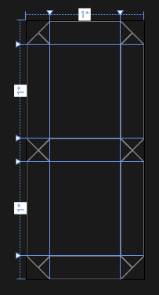
Digit
<UserControl x:Class="SampleWpf2025.Components.Digit"
xmlns="http://schemas.microsoft.com/winfx/2006/xaml/presentation"
xmlns:x="http://schemas.microsoft.com/winfx/2006/xaml"
xmlns:mc="http://schemas.openxmlformats.org/markup-compatibility/2006"
xmlns:d="http://schemas.microsoft.com/expression/blend/2008"
xmlns:local="clr-namespace:SampleWpf2025.Components" xmlns:converters="clr-namespace:SampleWpf2025.Converters"
mc:Ignorable="d"
x:Name="DigitControl">
<Grid Width="100" Height="220">
<Grid.ColumnDefinitions>
<ColumnDefinition Width="20"/>
<ColumnDefinition/>
<ColumnDefinition Width="20"/>
</Grid.ColumnDefinitions>
<Grid.RowDefinitions>
<RowDefinition Height="20"/>
<RowDefinition/>
<RowDefinition Height="20"/>
<RowDefinition/>
<RowDefinition Height="20"/>
</Grid.RowDefinitions>
<local:Mark Grid.Column="0" Grid.Row="0" Grid.ColumnSpan="3"
MarkVisible="{Binding Converter={converters:InputToDigitVisibleConverter}, ConverterParameter=0}"
Color="{Binding ElementName=DigitControl, Path=Score, Converter={converters:CounterToBrushConverter}}"/>
<local:Mark Grid.Column="0" Grid.Row="2" Grid.ColumnSpan="3"
MarkVisible="{Binding Converter={converters:InputToDigitVisibleConverter}, ConverterParameter=3}"
Color="{Binding ElementName=DigitControl, Path=Score, Converter={converters:CounterToBrushConverter}}"/>
<local:Mark Grid.Column="0" Grid.Row="4" Grid.ColumnSpan="3"
MarkVisible="{Binding Converter={converters:InputToDigitVisibleConverter}, ConverterParameter=6}"
Color="{Binding ElementName=DigitControl, Path=Score, Converter={converters:CounterToBrushConverter}}"/>
<local:Mark2 Grid.Column="0" Grid.Row="0" Grid.RowSpan="3"
MarkVisible="{Binding Converter={converters:InputToDigitVisibleConverter}, ConverterParameter=1}"
Color="{Binding ElementName=DigitControl, Path=Score, Converter={converters:CounterToBrushConverter}}"/>
<local:Mark2 Grid.Column="0" Grid.Row="2" Grid.RowSpan="3"
MarkVisible="{Binding Converter={converters:InputToDigitVisibleConverter}, ConverterParameter=4}"
Color="{Binding ElementName=DigitControl, Path=Score, Converter={converters:CounterToBrushConverter}}"/>
<local:Mark2 Grid.Column="2" Grid.Row="0" Grid.RowSpan="3"
MarkVisible="{Binding Converter={converters:InputToDigitVisibleConverter}, ConverterParameter=2}"
Color="{Binding ElementName=DigitControl, Path=Score, Converter={converters:CounterToBrushConverter}}"/>
<local:Mark2 Grid.Column="2" Grid.Row="2" Grid.RowSpan="3"
MarkVisible="{Binding Converter={converters:InputToDigitVisibleConverter}, ConverterParameter=5}"
Color="{Binding ElementName=DigitControl, Path=Score, Converter={converters:CounterToBrushConverter}}"/>
</Grid>
</UserControl>

Slide 8
Digit
using System.Windows;
using System.Windows.Controls;
namespace SampleWpf2025.Components;
public partial class Digit : UserControl
{
public Digit()
{
InitializeComponent();
}
public int Score
{
get { return (int)GetValue(ScoreProperty); }
set { SetValue(ScoreProperty, value); }
}
public static readonly DependencyProperty ScoreProperty =
DependencyProperty.Register("Score", typeof(int), typeof(Digit), new PropertyMetadata(0));
}

Slide 9
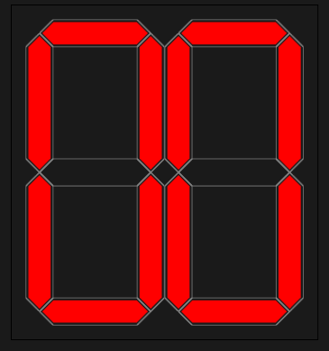
Number
<UserControl x:Class="SampleWpf2025.Components.Number"
xmlns="http://schemas.microsoft.com/winfx/2006/xaml/presentation"
xmlns:x="http://schemas.microsoft.com/winfx/2006/xaml"
xmlns:mc="http://schemas.openxmlformats.org/markup-compatibility/2006"
xmlns:d="http://schemas.microsoft.com/expression/blend/2008"
xmlns:local="clr-namespace:SampleWpf2025.Components"
xmlns:cv="clr-namespace:SampleWpf2025.Converters"
xmlns:components="clr-namespace:SampleWpf2025.Components"
mc:Ignorable="d"
x:Name="NumberControl">
<UniformGrid Grid.Row="1" Margin="10" Columns="2">
<Viewbox>
<components:Digit DataContext="{Binding Converter={cv:InputToDigitConverter}, ConverterParameter=1}" Score="{Binding ElementName=NumberControl, Path=DataContext}"/>
</Viewbox>
<Viewbox>
<components:Digit DataContext="{Binding Converter={cv:InputToDigitConverter}, ConverterParameter=0}" Score="{Binding ElementName=NumberControl, Path=DataContext}"/>
</Viewbox>
</UniformGrid>
</UserControl>

Slide 10
Converters
using System.Globalization;
using MVVM.Converters;
using SampleWpf2025.Extensions;
using static SampleWpf2025.Extensions.Extensions;
namespace SampleWpf2025.Converters;
internal class CounterToBrushConverter : ConverterBase<CounterToBrushConverter>
{
public override object Convert(object value, Type targetType, object parameter, CultureInfo culture)
{
if (value is not int counter) return NumberBrushes[NumberValue.Less55];
return counter < 55
? NumberBrushes[NumberValue.Less55]
: counter < 70
? NumberBrushes[NumberValue.Less70]
: counter < 86
? NumberBrushes[NumberValue.Less86]
: NumberBrushes[NumberValue.Perfect];
}
}

Slide 11
Converters
using MVVM.Converters;
using System.Globalization;
namespace SampleWpf2025.Converters;
internal class InputToDigitConverter : ConverterBase<InputToDigitConverter>
{
public override object Convert(object value, Type targetType, object parameter, CultureInfo culture)
{
if (value is not int counter) return 0;
if (!int.TryParse(parameter.ToString(), out var index)) return 0;
if (index == 0 && counter > 0 && counter < 10) return counter;
if (index == 0 && counter < 100) return counter % 10;
if (index == 1 && counter < 10) return 0;
if (index == 1 && counter < 100) return counter / 10;
return 0;
}
}

Slide 12
Converters
using MVVM.Converters;
using System.Globalization;
using System.Windows;
namespace SampleWpf2025.Converters;
internal class InputToDigitVisibleConverter : ConverterBase<InputToDigitVisibleConverter>
{
public override object Convert(object value, Type targetType, object parameter, CultureInfo culture)
{
if (value is not int counter) return Visibility.Collapsed;
if (!int.TryParse(parameter.ToString(), out var index)) return Visibility.Collapsed;
switch (index)
{
case 0:
if (counter == 0 ||
counter == 2 ||
counter == 3 ||
counter == 5 ||
counter == 6 ||
counter == 7 ||
counter == 8 ||
counter == 9) return Visibility.Visible;
break;
case 1:
if (counter == 0 ||
counter == 4 ||
counter == 5 ||
counter == 6 ||
counter == 8 ||
counter == 9) return Visibility.Visible;
break;
case 2:
if (counter == 0 ||
counter == 1 ||
counter == 2 ||
counter == 3 ||
counter == 4 ||
counter == 7 ||
counter == 8 ||
counter == 9) return Visibility.Visible;
break;
case 3:
if (counter == 2 ||
counter == 3 ||
counter == 4 ||
counter == 5 ||
counter == 6 ||
counter == 8 ||
counter == 9) return Visibility.Visible;
break;
case 4:
if (counter == 0 ||
counter == 2 ||
counter == 6 ||
counter == 8) return Visibility.Visible;
break;
case 5:
if (counter == 0 ||
counter == 1 ||
counter == 3 ||
counter == 4 ||
counter == 5 ||
counter == 6 ||
counter == 7 ||
counter == 8 ||
counter == 9) return Visibility.Visible;
break;
case 6:
if (counter == 0 ||
counter == 2 ||
counter == 3 ||
counter == 5 ||
counter == 6 ||
counter == 8 ||
counter == 9) return Visibility.Visible;
break;
}
return Visibility.Collapsed;
}
}

Slide 13
Extensions
using System.Windows.Media;
namespace SampleWpf2025.Extensions;
internal class Extensions
{
public static readonly Dictionary<NumberValue, Brush> NumberBrushes = new()
{
{ NumberValue.Less55, new SolidColorBrush(Colors.LightCoral) },
{ NumberValue.Less70, new SolidColorBrush(Colors.LightBlue) },
{ NumberValue.Less86, new SolidColorBrush(Colors.LightGreen) },
{ NumberValue.Perfect, new SolidColorBrush(Colors.Gold) },
};
}

Slide 14
Extensions
namespace SampleWpf2025.Extensions;
public enum NumberValue
{
Less55,
Less70,
Less86,
Perfect
}

Slide 15
IModel
using System.Collections.ObjectModel;
using System.ComponentModel;
namespace SampleWpf2025.Abstractions;
public interface IModel : INotifyPropertyChanged
{
int Input { get; set; }
ObservableCollection<int> History { get; }
}

Slide 16
ViewModel stage 2
using MVVM.Commands;
using MVVM.Extensions;
using SampleWpf2025.Abstractions;
using SampleWpf2025.Models;
using SampleWpf2025.Services;
using System.Collections.Specialized;
using System.Reactive.Linq;
using System.Windows.Input;
namespace SampleWpf2025.ViewModels;
internal class MainViewModel
{
public IModel Model { get; } = new MainModel();
public ServiceModel Service { get; } = new();
public MainViewModel()
{
Model.WhenPropertyChanged(x => x.Input, CheckCommands);
Model.History.CollectionChanged += HistoryOnCollectionChanged;
Clear = new RelayCommand(() => Service.Clear(Model), () => Model.History.Any());
Pop = new RelayCommand(() => Service.Pop(Model), CanPop);
Push = new RelayCommand(() => Service.Push(Model), CanPush);
Rand = new RelayCommand(() => Service.Random(Model));
}
public ICommand Clear { get; set; }
public ICommand Push { get; set; }
public ICommand Pop { get; set; }
public ICommand Rand { get; set; }
private bool CanPop() => Model.History.Any();
private bool CanPush() => Model.Input >= 0 && Model.Input <= 99;
private void HistoryOnCollectionChanged(object sender, NotifyCollectionChangedEventArgs e)
{
Clear.RaiseCanExecuteChanged();
}
private void CheckCommands()
{
Pop.RaiseCanExecuteChanged();
Push.RaiseCanExecuteChanged();
}
}

Slide 17
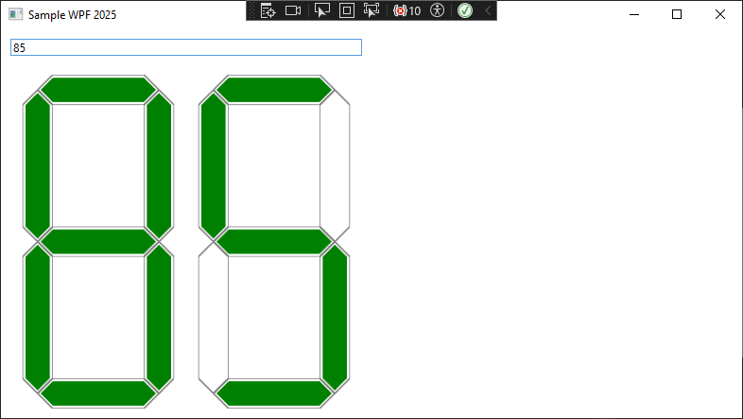
MainView

Slide 18
ButtonsControl
<UserControl x:Class="SampleWpf2025.Components.ButtonsControl"
xmlns="http://schemas.microsoft.com/winfx/2006/xaml/presentation"
xmlns:x="http://schemas.microsoft.com/winfx/2006/xaml"
xmlns:mc="http://schemas.openxmlformats.org/markup-compatibility/2006"
xmlns:d="http://schemas.microsoft.com/expression/blend/2008"
xmlns:local="clr-namespace:SampleWpf2025.Components"
xmlns:vm="clr-namespace:SampleWpf2025.ViewModels"
mc:Ignorable="d"
d:DesignHeight="450"
d:DesignWidth="800"
d:DataContext="{d:DesignInstance vm:MainViewModel}">
<Grid>
<Grid.ColumnDefinitions>
<ColumnDefinition Width="*"/>
<ColumnDefinition Width="*"/>
</Grid.ColumnDefinitions>
<Grid.RowDefinitions>
<RowDefinition Height="*"/>
<RowDefinition Height="*"/>
</Grid.RowDefinitions>
<Button Command="{Binding Push}"
Content="PUSH"/>
<Button Content="RAND" Grid.Column="1" Grid.Row="0"
Style="{StaticResource StyleGreen}"
Command="{Binding Rand}"/>
<Button Content="POP" Grid.Column="0" Grid.Row="1"
Command="{Binding Pop}"/>
<Button Content="CLEAR" Grid.Column="1" Grid.Row="1"
Command="{Binding Clear}"/>
</Grid>
</UserControl>

Slide 19
Global styles
<Application x:Class="SampleWpf2025.App"
xmlns="http://schemas.microsoft.com/winfx/2006/xaml/presentation"
xmlns:x="http://schemas.microsoft.com/winfx/2006/xaml"
xmlns:local="clr-namespace:SampleWpf2025"
StartupUri="Views/MainView.xaml">
<Application.Resources>
<Style x:Key="StyleGreen" TargetType="Button" >
<Setter Property="FontSize" Value="24"/>
<Setter Property="Margin" Value="5"/>
<Setter Property="Background" Value="LightGreen"/>
</Style>
<Style TargetType="TextBox">
<Setter Property="FontSize" Value="48"/>
<Setter Property="Padding" Value="0"/>
<Setter Property="Background" Value="LightGray"/>
</Style>
<Style TargetType="Button" BasedOn="{StaticResource StyleGreen}">
<Setter Property="Background" Value="LightCoral"/>
</Style>
</Application.Resources>
</Application>

Slide 20
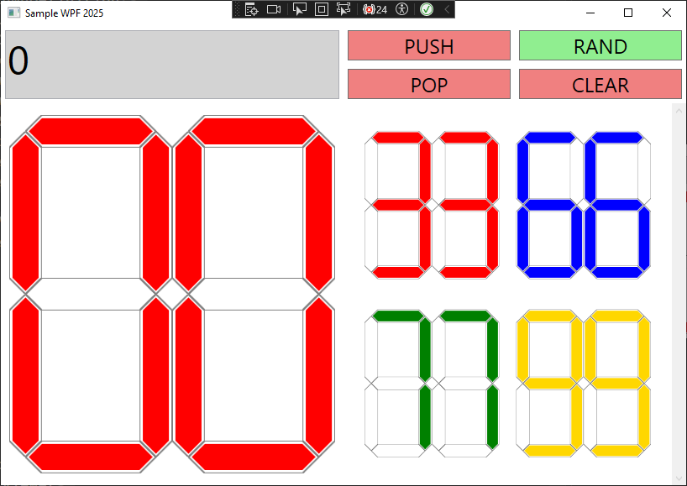
MainView stage 2

Slide 21
MainView
<Window x:Class="SampleWpf2025.Views.MainView"
xmlns="http://schemas.microsoft.com/winfx/2006/xaml/presentation"
xmlns:x="http://schemas.microsoft.com/winfx/2006/xaml"
xmlns:d="http://schemas.microsoft.com/expression/blend/2008"
xmlns:mc="http://schemas.openxmlformats.org/markup-compatibility/2006"
xmlns:local="clr-namespace:SampleWpf2025.Views"
xmlns:components="clr-namespace:SampleWpf2025.Components"
xmlns:vm="clr-namespace:SampleWpf2025.ViewModels"
xmlns:cv="clr-namespace:SampleWpf2025.Converters"
mc:Ignorable="d"
Title="Sample WPF 2025" Height="450" Width="800">
<Window.DataContext>
<vm:MainViewModel/>
</Window.DataContext>
<Grid>
<Grid.ColumnDefinitions>
<ColumnDefinition/>
<ColumnDefinition/>
</Grid.ColumnDefinitions>
<Grid.RowDefinitions>
<RowDefinition Height="Auto"/>
<RowDefinition/>
</Grid.RowDefinitions>
<TextBox Text="{Binding Model.Input, UpdateSourceTrigger=PropertyChanged}" Margin="5"/>
<components:Number DataContext="{Binding Model.Input}" Grid.Row="1"/>
<components:ButtonsControl Grid.Column="1"/>
<ScrollViewer Grid.Row="1" Grid.Column="1">
<ItemsControl ItemsSource="{Binding Path=Model.History}">
<ItemsControl.ItemsPanel>
<ItemsPanelTemplate>
<UniformGrid Margin="15"/>
</ItemsPanelTemplate>
</ItemsControl.ItemsPanel>
<ItemsControl.ItemTemplate>
<DataTemplate>
<components:Number DataContext="{Binding Mode=OneWay}"/>
</DataTemplate>
</ItemsControl.ItemTemplate>
</ItemsControl>
</ScrollViewer>
</Grid>
</Window>

Slide 22
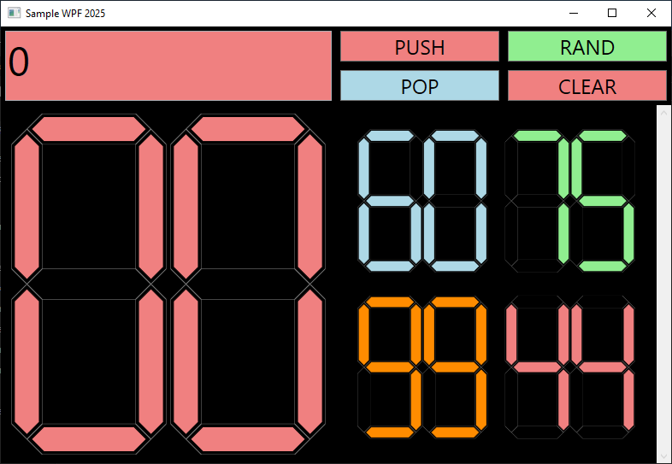
MainViewFinal

